Slide 1
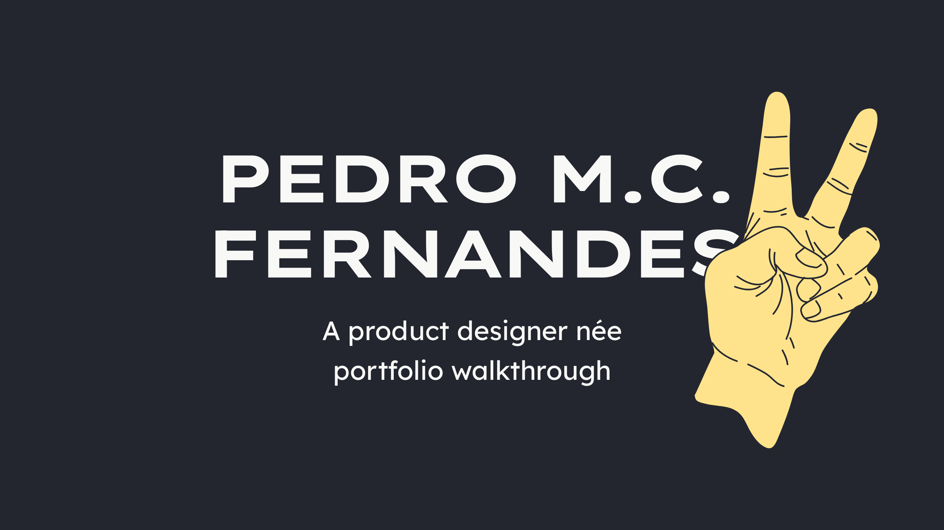

Slide 2


Slide 3
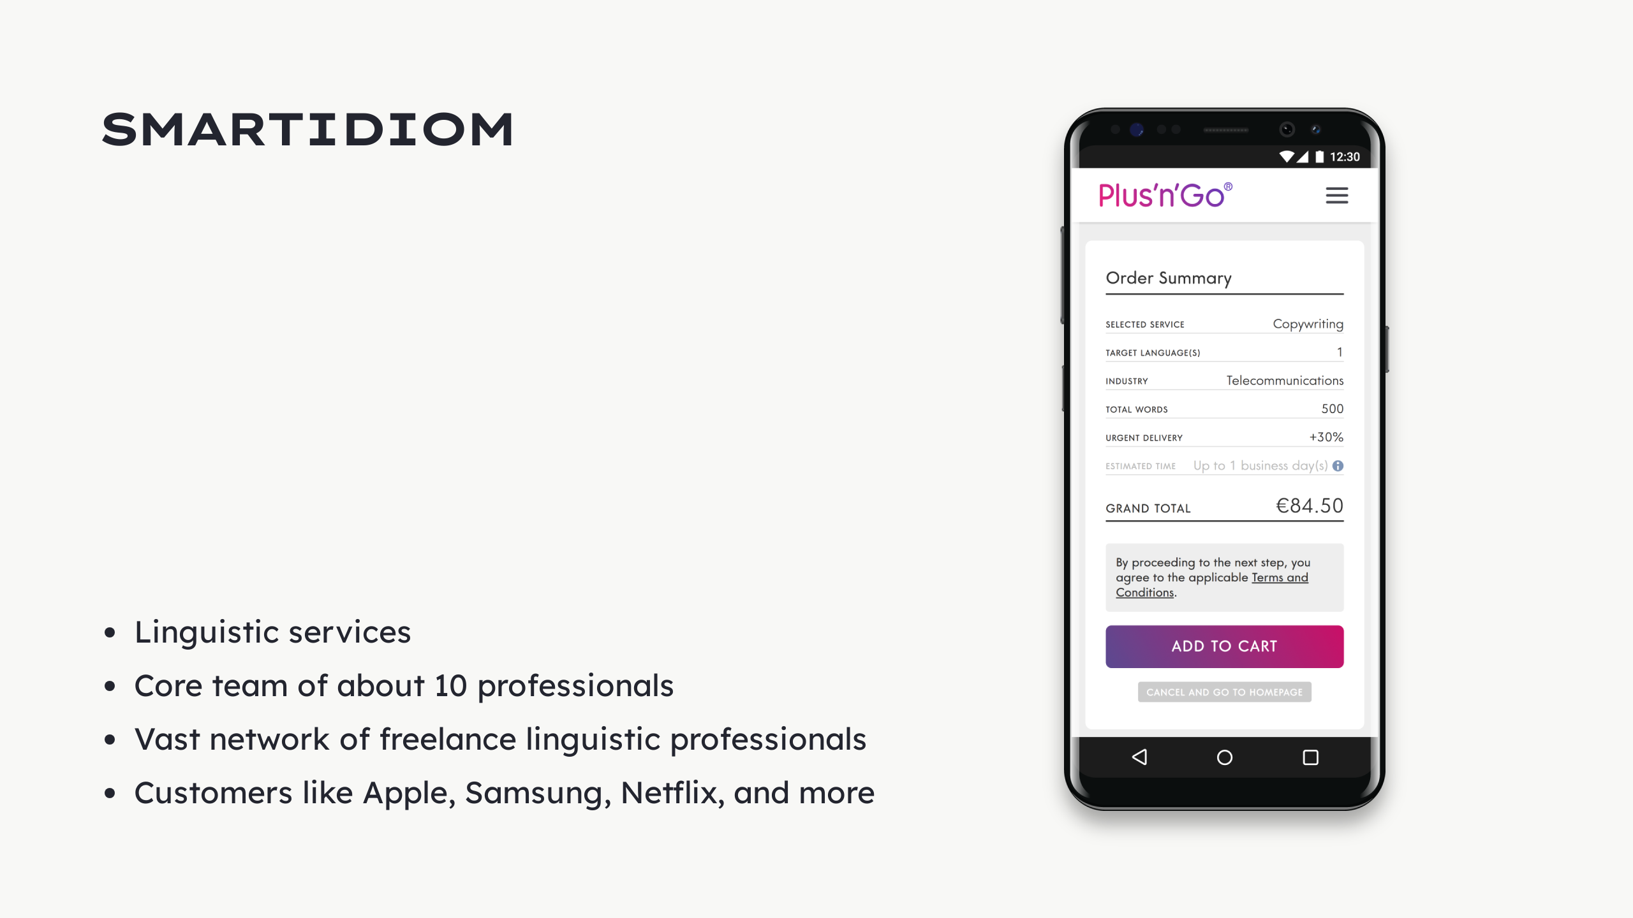

Slide 4


Slide 5
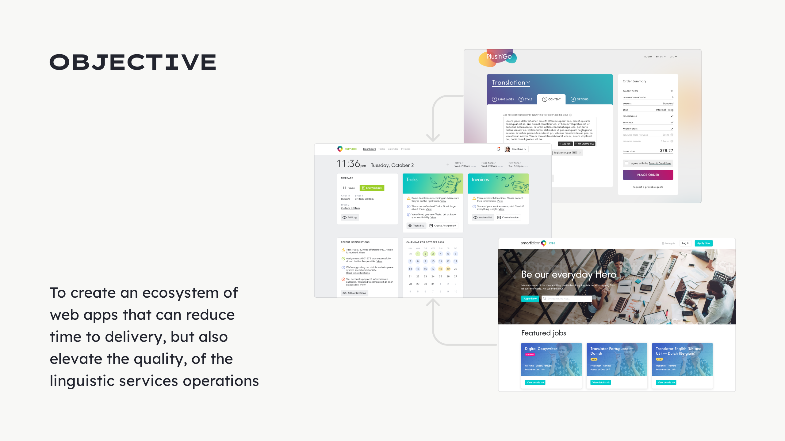

Slide 6

Notes:
Scoped style

Slide 7
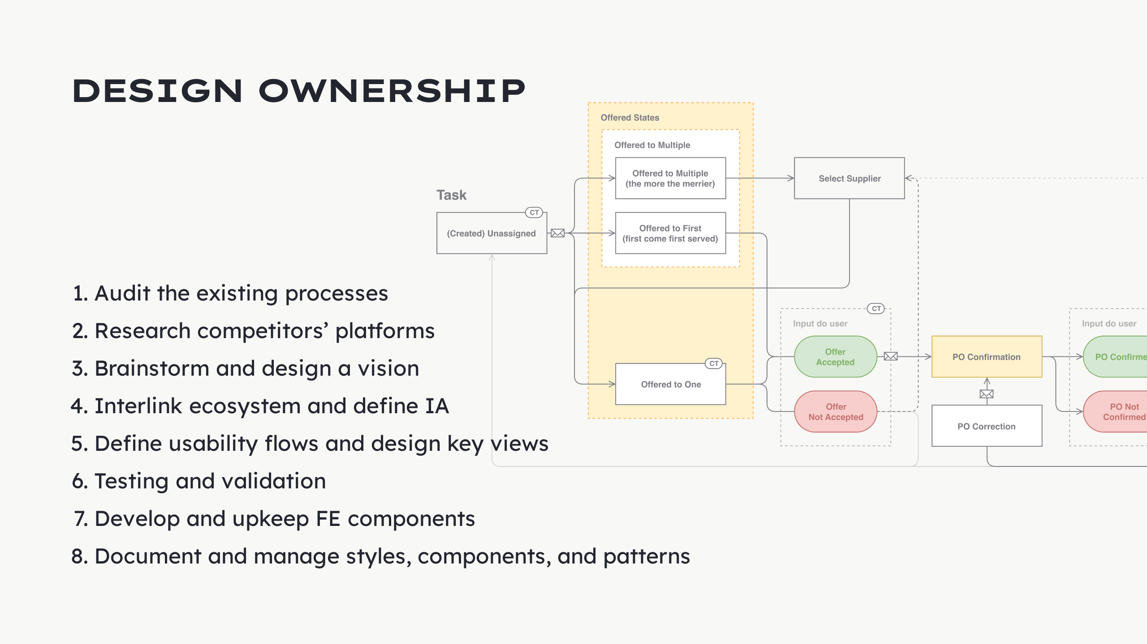

Slide 8


Slide 9
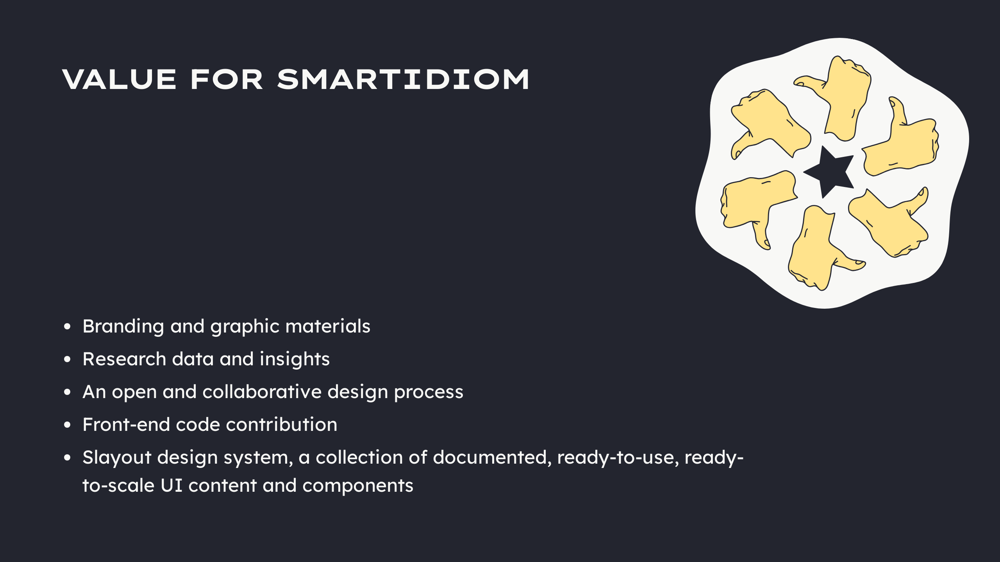

Slide 10


Slide 11
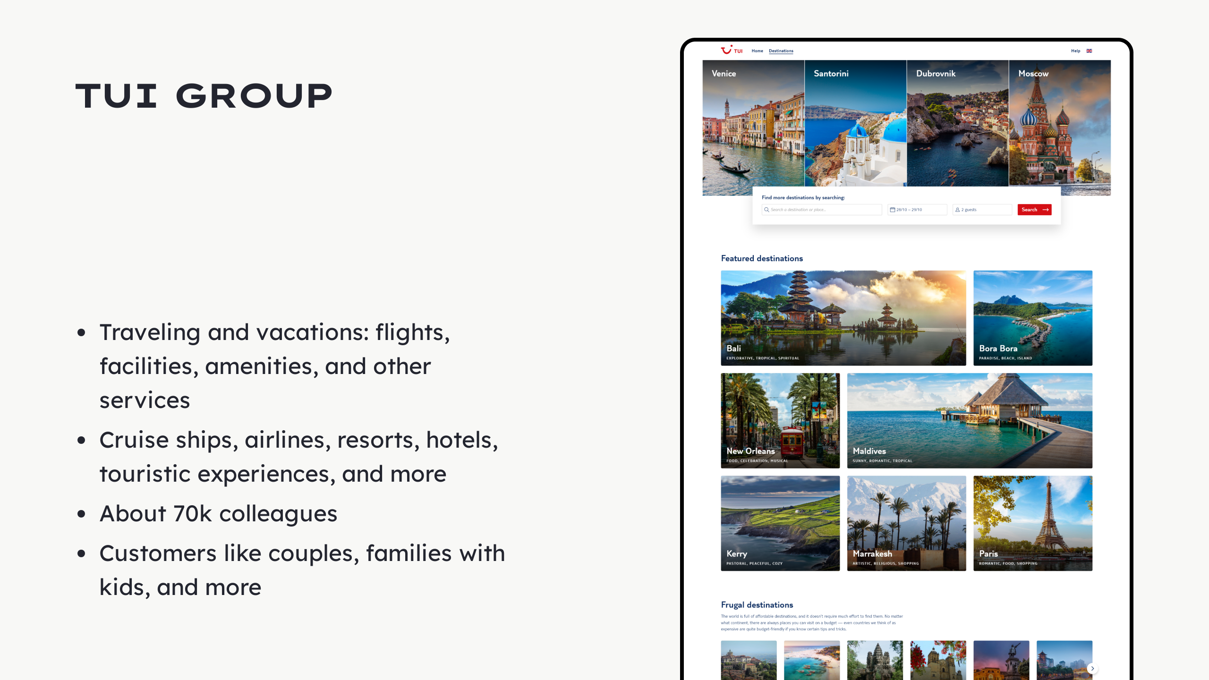

Slide 12
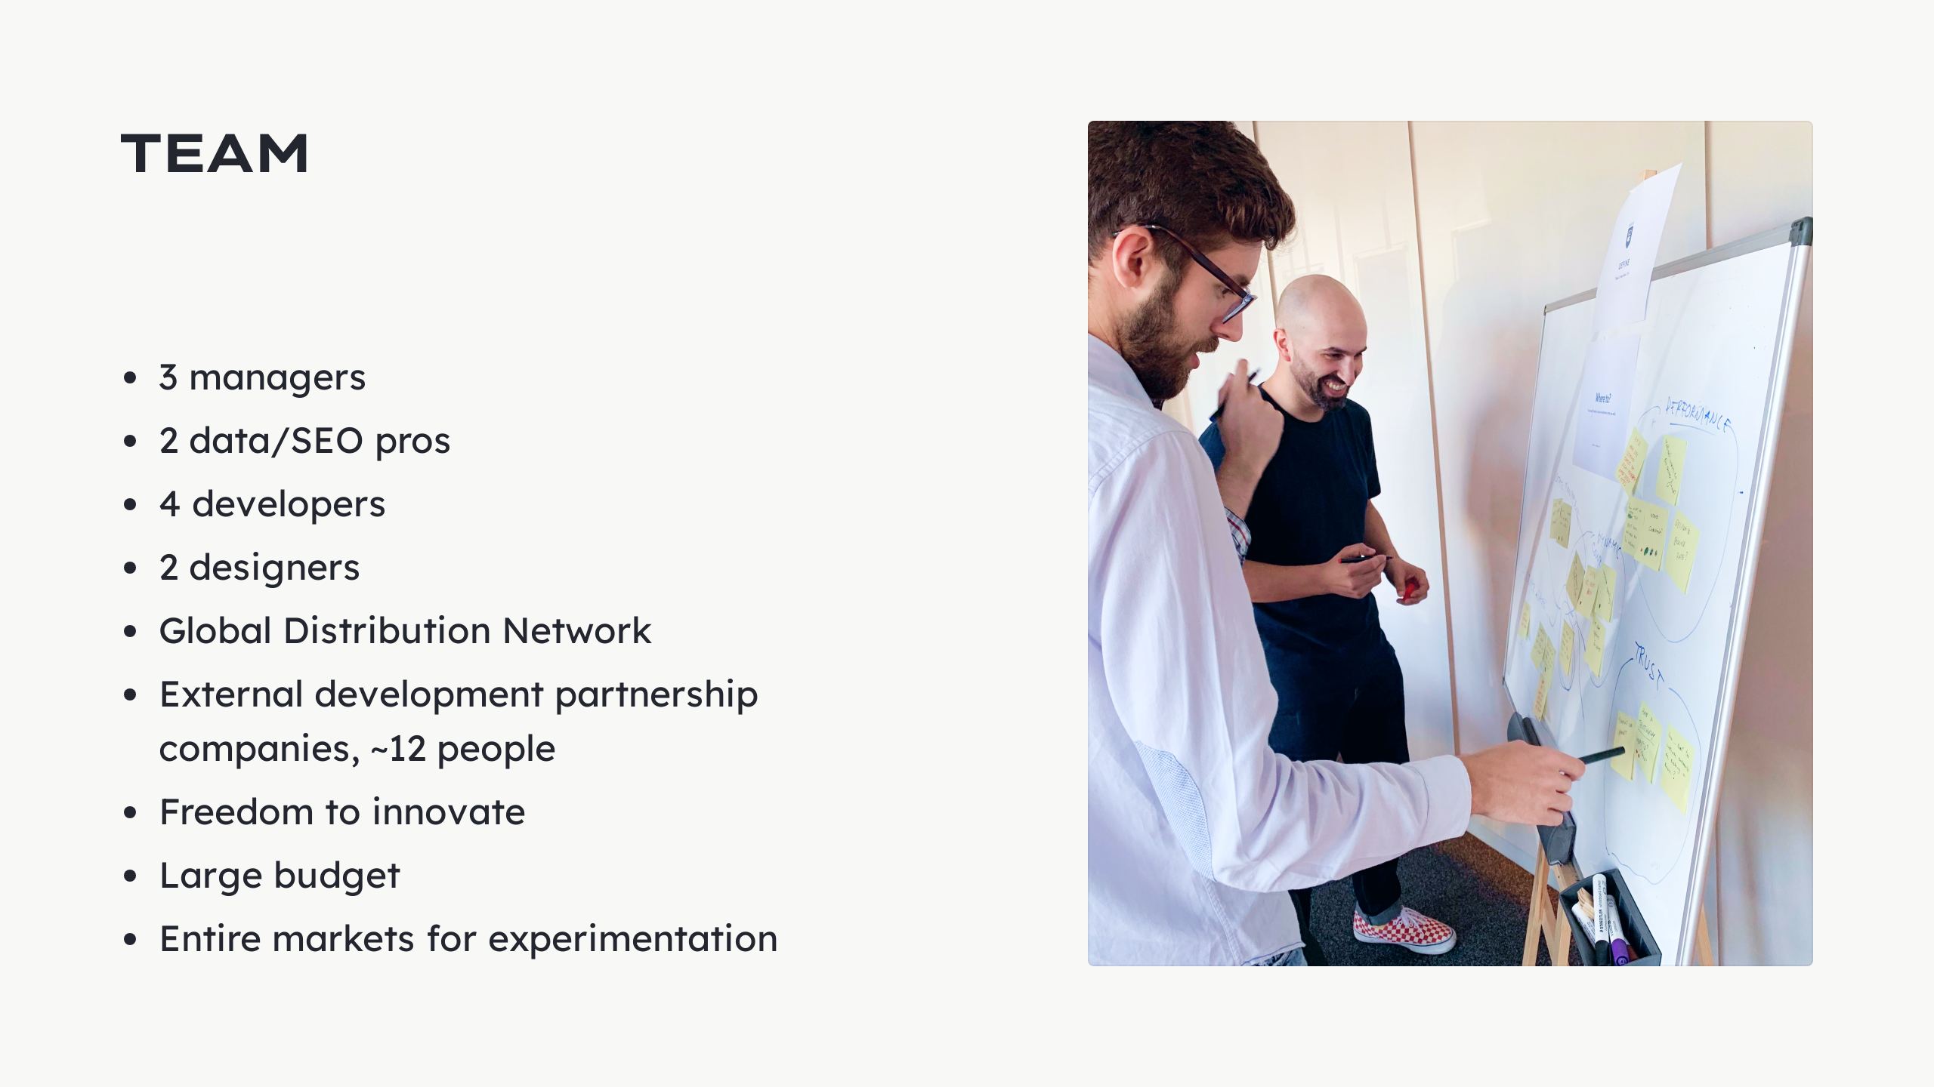

Slide 13


Slide 14
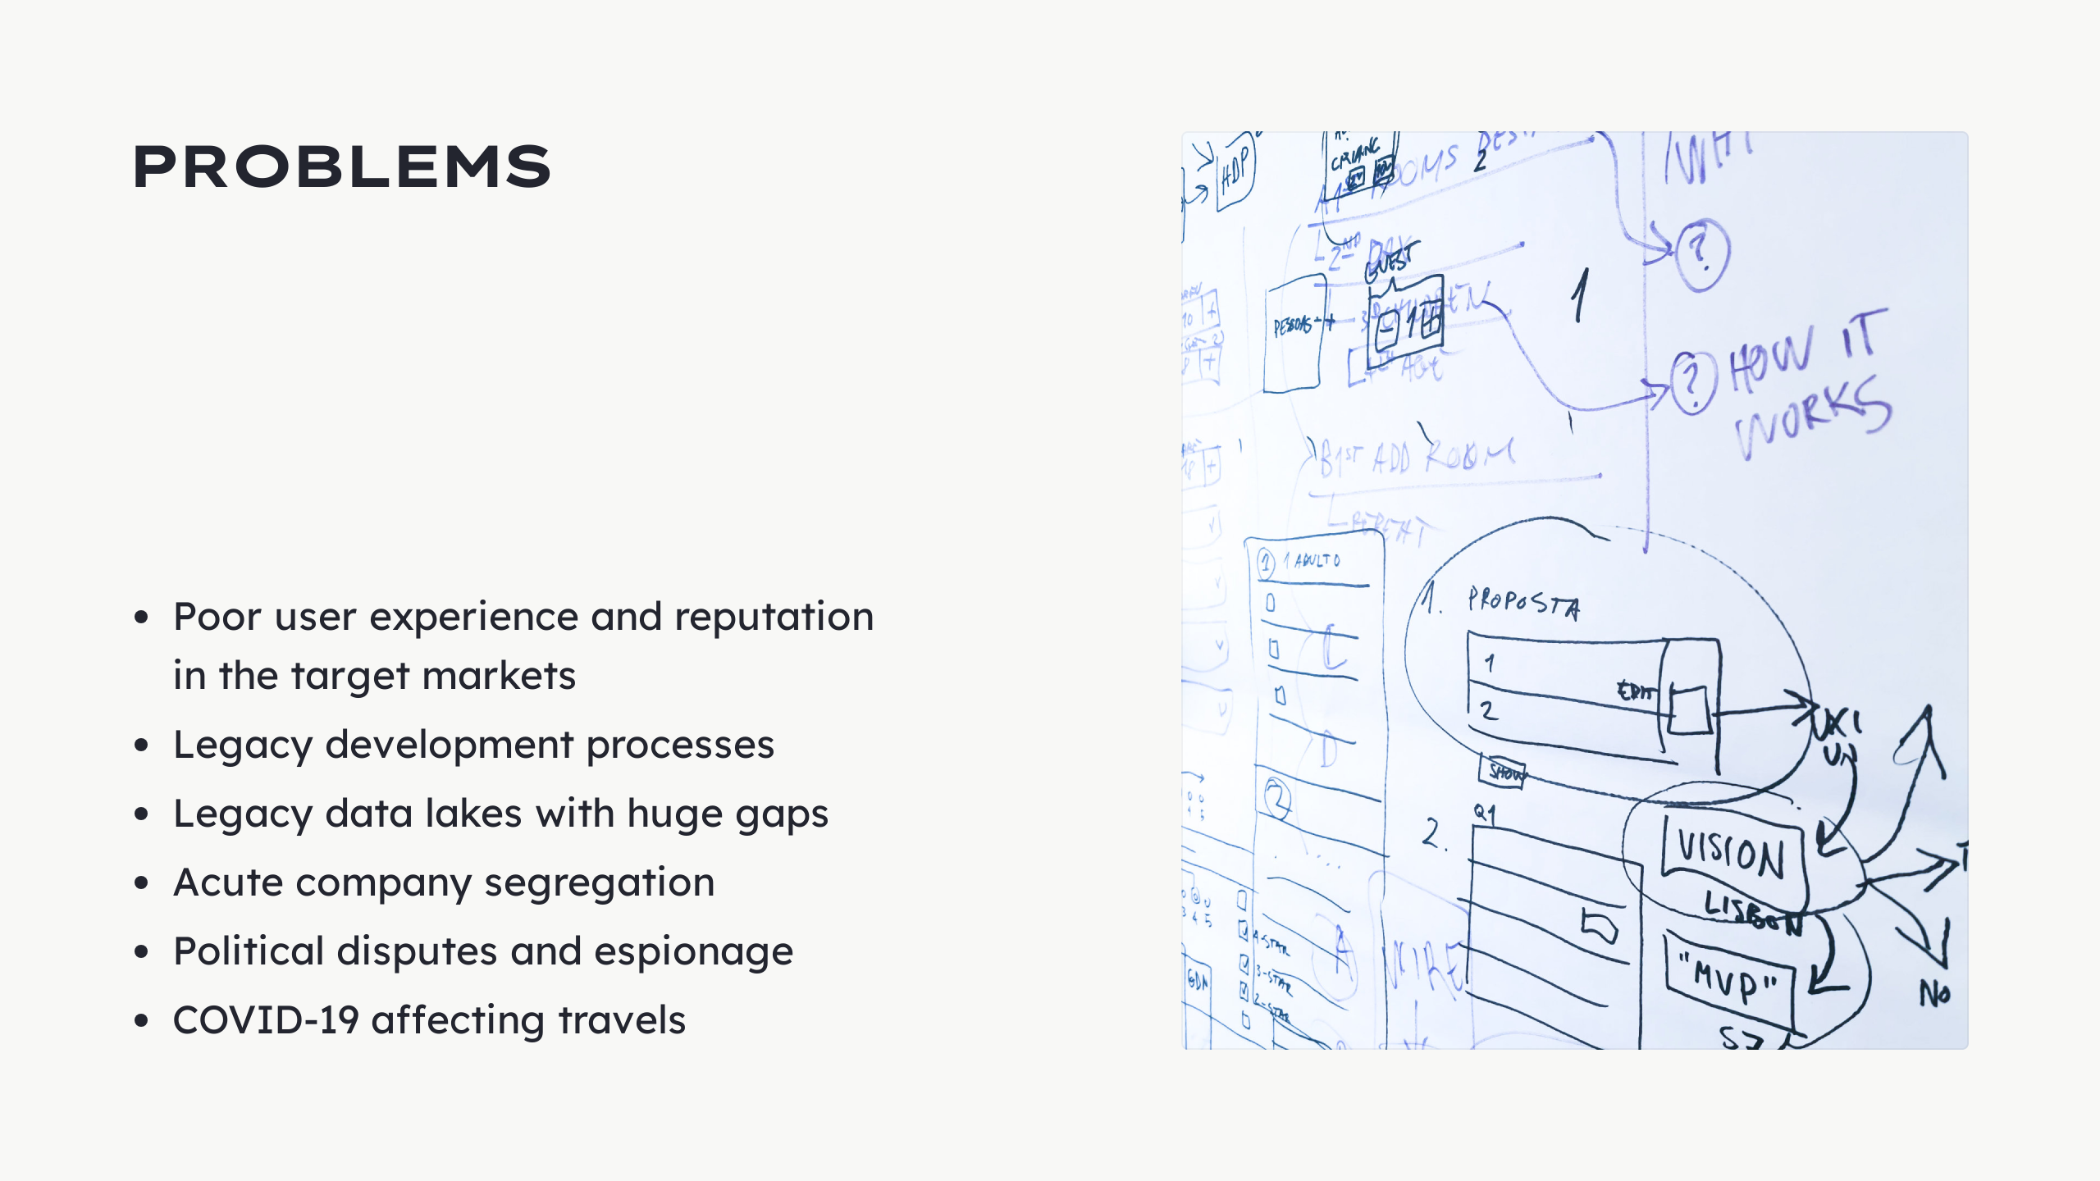

Slide 15
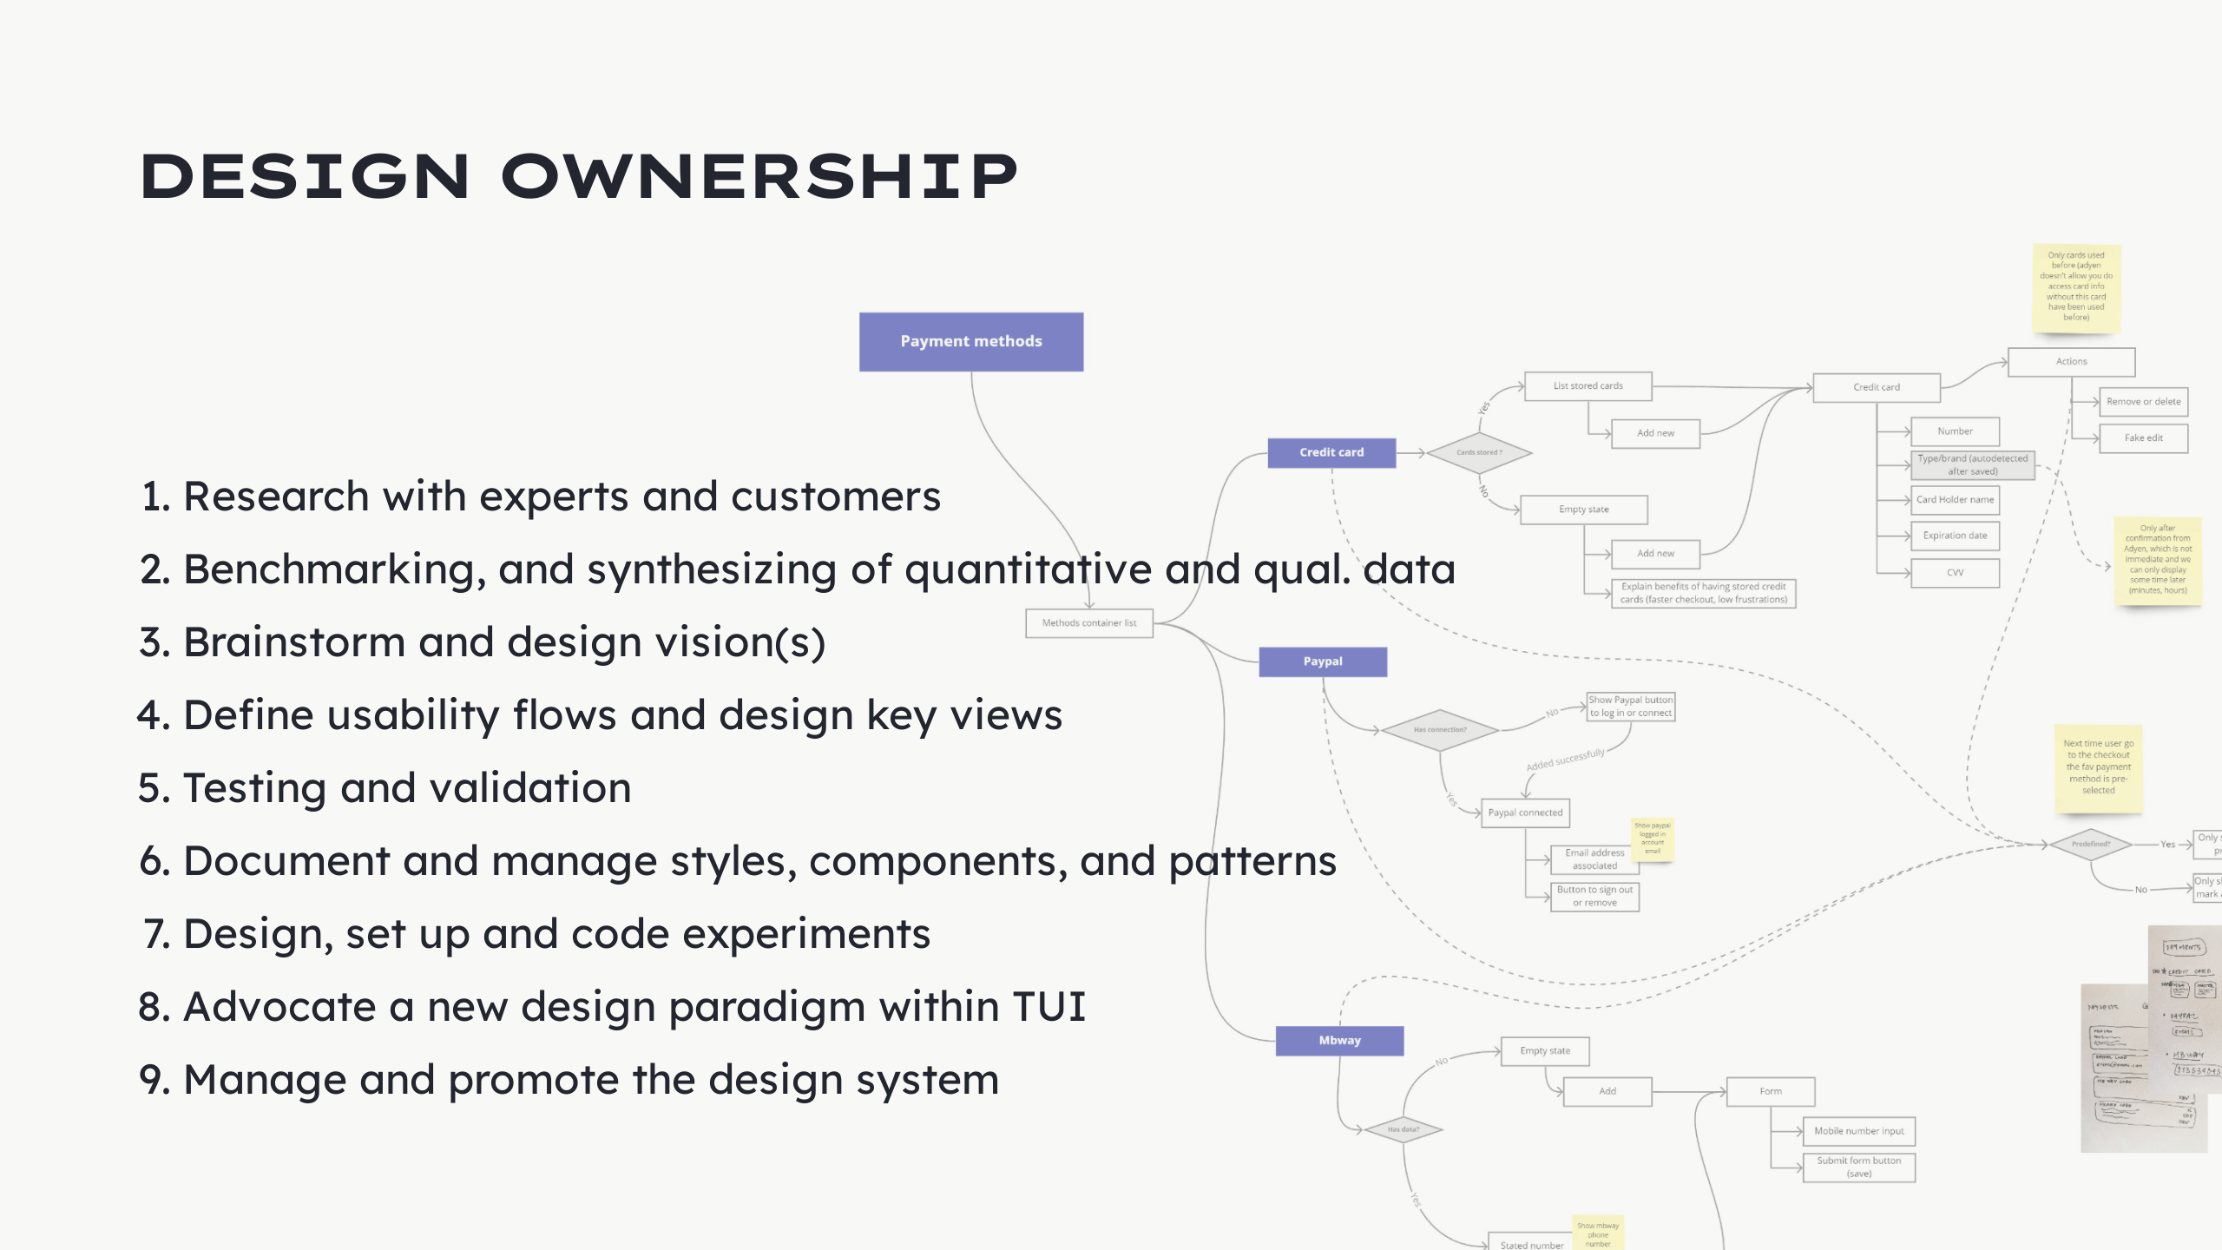

Slide 16
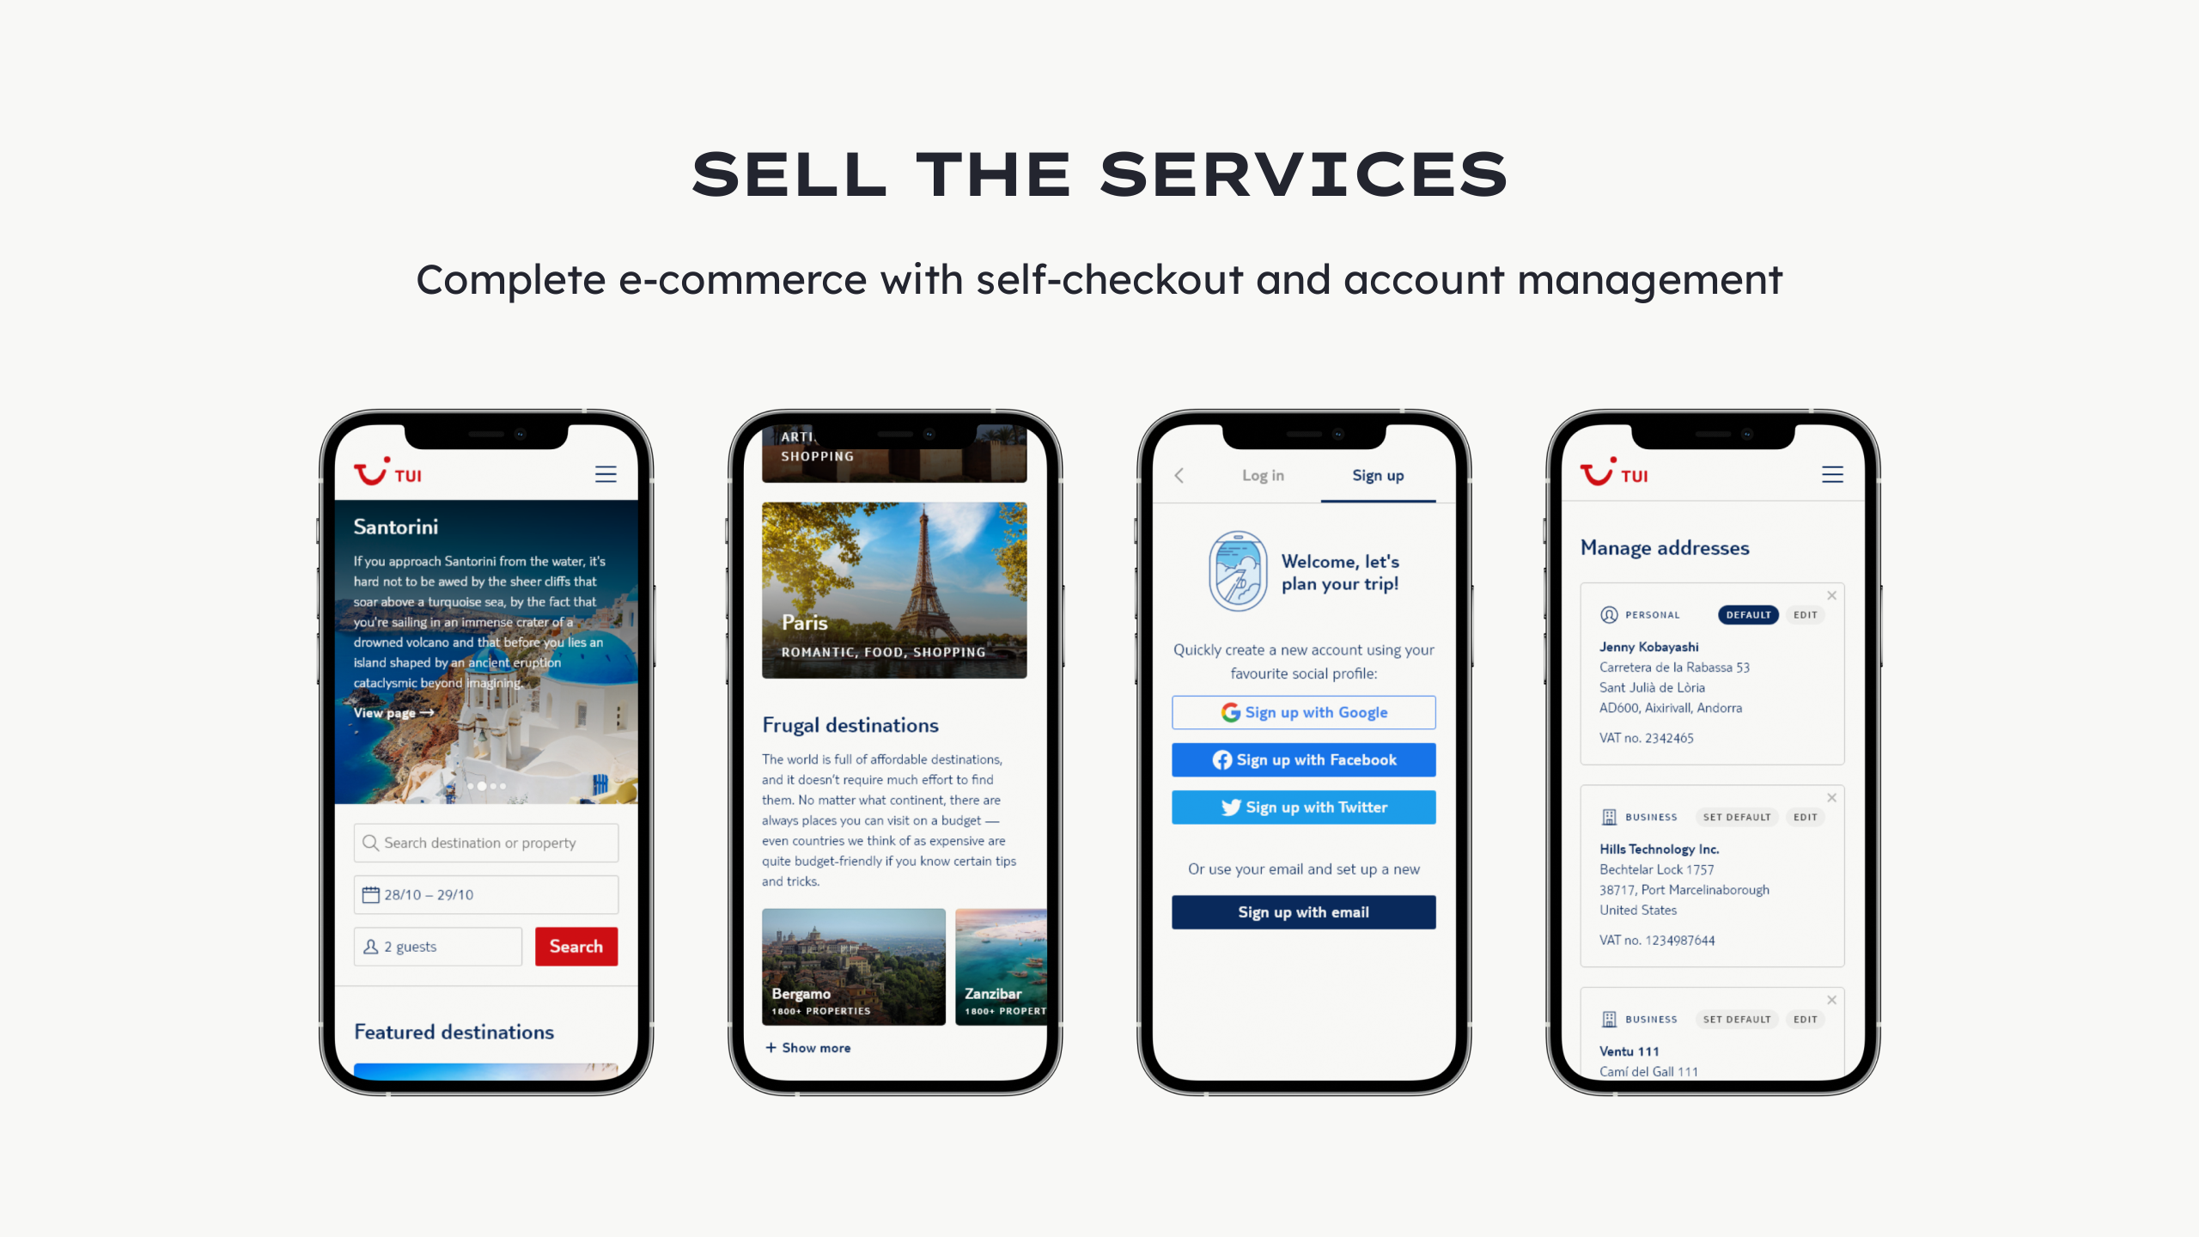

Slide 17


Slide 18


Slide 19


Slide 20


Slide 21

Notes:
![](../img/portfolio/holie.gif)

Slide 22
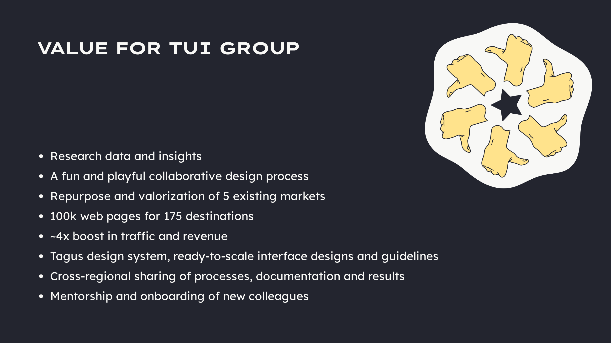
Notes:
--- ## Percona - Database-focused services and open-source software - About 300 colleagues - Users and customers from hobbyists and non-profit, to education, tech, government, and more --- ### Team - 5 managers - 2 designers - Untapped design opportunities --- ### Objectives Improve the overall user experience across all open-source software --- ### Problems - Hazy direction and vision - Multiple reports of poor user experience - Profound design debt - Near-zero product, research, design, and experimentation cultures - Instability and uncertainty - Lack of clear intention with design --- ### Process 1. Research with experts and customers 2. Design a vision 3. Create user flows and design key screens 4. Define and document processes 5. Advocate for a culture of problem-solving and innovation 6. Document design, styles, and components 7. Test and set up experiments 8. Own, promote, and upkeep design system --- ### Documentation --- ### PMM

Slide 23


